Slide 1
Containers
Pravin Y Pawar

Slide 2
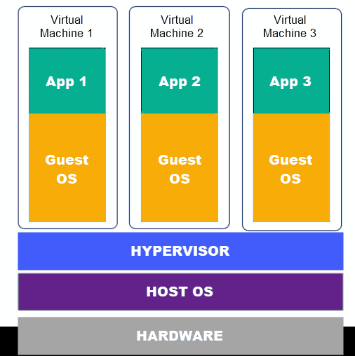
Virtual Machines
A virtual machine (VM) is system that shares the physical resources of one server
is a guest on the host’s hardware, which is why it is also called a guest machine
Several layers make up a virtual machine
The layer that enables virtualization is the hypervisor
A hypervisor is a software that virtualizes the server
Everything necessary to run an app is contained within the virtual machine –
the virtualized hardware
an OS
any required binaries and libraries
Virtual machines have their own infrastructure and are self-contained
Disadvantages
Virtual machines may take up a lot of system resources of the host machine
The process of relocating an app running on a virtual machine can also be complicated

Slide 3
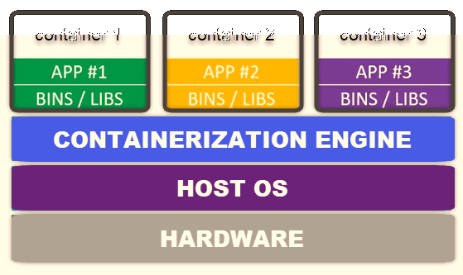
Containers
A container is an environment that runs an application that is not dependent on the operating system
isolates the app from the host by virtualizing it
allows users to created multiple workloads on a single OS instance
cannot harm the host machine nor come in conflict with other apps running in separate containers
The kernel of the host operating system serves the needs of running different functions of an app, separated into containers
Can create a template of an environment you need
The container essentially runs a snapshot of the system at a particular time
providing consistency in the behavior of an app
The container shares the host’s kernel to run all the individual apps within the container
The only elements that each container requires are bins, libraries and other runtime components

Slide 4
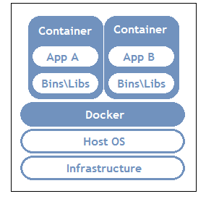
Containers(2)
Containers were brought into spotlight by start-ups and born-in-cloud companies
Over couple of years, they have become synonymous with app modernization
Mainly people talk about Docker containers
It has really made container popular
But other container runtimes are also available such as
Containerd
CoreOS rkt
Hyper-V Containers
LXC Linux Containers
OpenVZ
RunC
Vagrant

Slide 5
Benefits of containers
Less overhead
Containers require less system resources than traditional or hardware virtual machine environments because they don’t include operating system images.
Increased portability
Applications running in containers can be deployed easily to multiple different operating systems and hardware platforms.
More consistent operation
DevOps teams know applications in containers will run the same, regardless of where they are deployed.
Greater efficiency
Containers allow applications to be more rapidly deployed, patched, or scaled.
Better application development
Containers support agile and DevOps efforts to accelerate development, test, and production cycles.

Slide 6
Container use cases
“Lift and shift” existing applications into modern cloud architectures
Some organizations use containers to migrate existing applications into more modern environments
does not offer the full benefits of a modular, container-based application architecture
Refactor existing applications for containers
Although refactoring is much more intensive than lift-and-shift migration, it enables the full benefits of a container environment.
Develop new container-native applications
Much like refactoring, this approach unlocks the full benefits of containers.
Provide better support for microservices architectures
Distributed applications and microservices can be more easily isolated, deployed, and scaled using individual container building blocks.
Provide DevOps support for continuous integration and deployment (CI/CD)
Container technology supports streamlined build, test, and deployment from the same container images.
Provide easier deployment of repetitive jobs and tasks
Containers are being deployed to support one or more similar processes, which often run in the background, such as ETL functions or batch jobs.

Slide 7
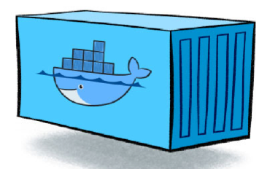
Containers in Cloud native
Cloud native apps are distributed in nature and utilize cloud infrastructure
Many technologies and tools used for implementation
From compute perspective – its only containers and functions
From architectural perspective – its microservices
These terms are mistakenly used and often believed to be one and the same
Understanding how to best use functions and containers, along with eventing or messaging technologies, allows developers to design, develop and operate new generation of cloud-native microservices based applications
source

Slide 8
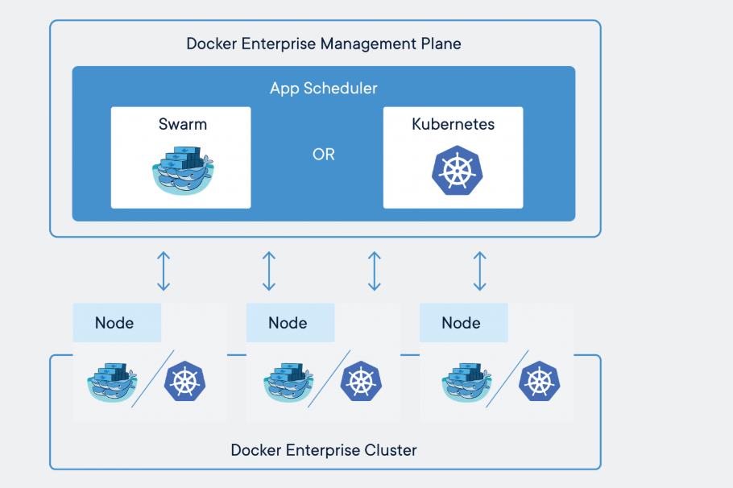
Containers in Production
Containers are a form of operating system virtualization
A single container might be used to run anything from a small microservices or software process to a larger application
Inside a container are all the necessary executables, binary code, libraries, and configuration files
Containers do not contain operating system images
makes them more lightweight and portable, with significantly less overhead
In larger application deployments, multiple containers may be deployed as one or more container clusters
Such clusters might be managed by a container orchestrator such as Kubernetes
Source : medium

Slide 9
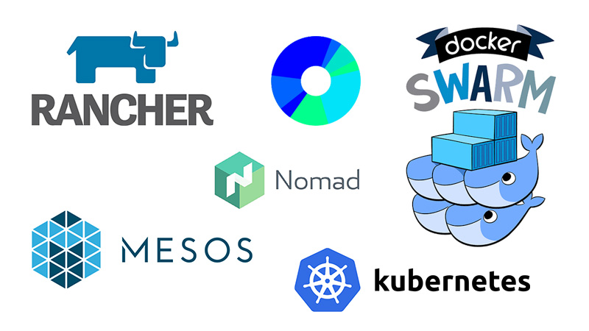
Container Orchestration
Tasks of container orchestrator
Provisioning and deployment of containers onto cluster nodes
Resource management of containers
Placing containers on nodes having sufficient resources
Moving containers to other nodes if resource limits is reached on node
Health monitoring of containers
Container restarting, rescheduling in case of failures of container or node
Scaling in or out containers within a cluster
Providing mapping for containers to connect to the networks
Initial load balancing between containers
source

Slide 10
Thank You!
In our next session:

